Slide 1
Introduction to Databases
Lucas Cordova
Oregon Institute of Technology

Slide 2
Learning Objectives (1 of 2)
1.1 Some common uses of database systems.
1.2 Characteristics of file-based systems.
1.3 Problems with file-based approach.
1.4 Meaning of the term database.
1.5 Meaning of the term Database Management System (D B M S).

Slide 3
Learning Objectives (2 of 2)
1.6 Typical functions of a D B M S.
1.7 Major components of the D B M S environment.
1.8 Personnel involved in the D B M S environment.
1.9 History of the development of D B M S s.
1.10 Advantages and disadvantages of D B M S s.

Slide 4
Examples of Database Applications
Purchases from the supermarket
Purchases using your credit card
Booking a holiday at the travel agents
Using the local library
Taking out insurance
Renting a video
Using the Internet
Studying at university

Slide 5
File-Based Systems
Collection of application programs that perform services for the end users (e.g. reports).
Each program defines and manages its own data.

Slide 6
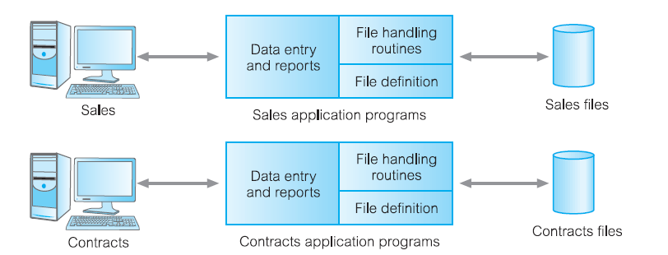
File-Based Processing
Sales Files
Property For Rent (property N o, street, city, postcode, type, rooms, rent, and owner N o)
Private Owner (owner N o, f Name, l Name, address, tel N o)
Client (client N o, f Name, l Name, address, tel N o, pref Type, max Rent)
Contracts files
Lease (lease N o, property N o, client N o, rent, payment Method, deposit, paid, rent Start, rent Finish, duration)
Property For Rent (property N o, street, city, postcode, rent)
Client (client N o, f Name, l Name, address, tel N o)

Slide 7
Limitations of File-Based Approach (1 of 2)
Separation and isolation of data
Each program maintains its own set of data.
Users of one program may be unaware of potentially useful data held by other programs.
Duplication of data
Same data is held by different programs.
Wasted space and potentially different values and/or different formats for the same item.

Slide 8
Limitations of File-Based Approach (2 of 2)
Data dependence
File structure is defined in the program code.
Incompatible file formats
Programs are written in different languages, and so cannot easily access each other’s files.
Fixed Queries/Proliferation of application programs
Programs are written to satisfy particular functions.
Any new requirement needs a new program.

Slide 9
Database Approach (1 of 3)
Arose because:
Definition of data was embedded in application programs, rather than being stored separately and independently.
No control over access and manipulation of data beyond that imposed by application programs.
Result:
the database and Database Management System (D B M S).

Slide 10
Database
Shared collection of logically related data (and a description of this data), designed to meet the information needs of an organization.
System catalog (metadata) provides description of data to enable program–data independence.
Logically related data comprises entities, attributes, and relationships of an organization’s information.

Slide 11
Database Management System (D B M S) (1 of 2)
A software system that enables users to define, create, maintain, and control access to the database.
(Database) application program: a computer program that interacts with database by issuing an appropriate request (S Q L statement) to the D B M S.

Slide 12
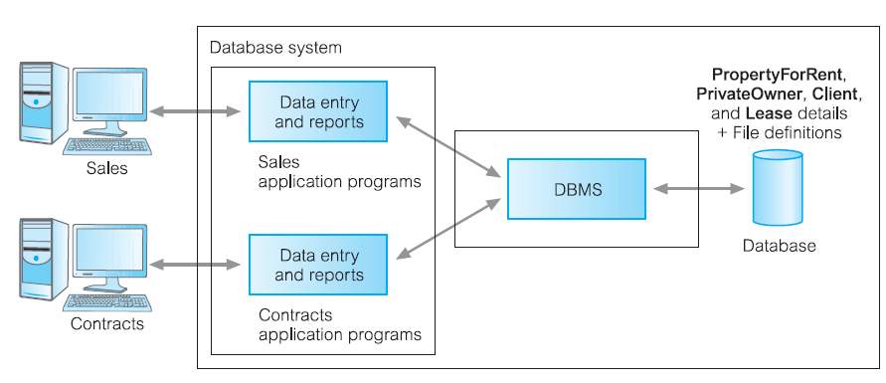
Database Management System (D B M S) (2 of 2)
Property For Rent (property N o, street, city, postcode, type, rooms, rent, owner N o)
Private Owner (owner N o, f name, l Name, address, tel N o)
Client (client N o, f Name, l Name, address, tel N o, pref Type, max Rent)
Lease (lease N o, property N o, client N o, payment Method, deposit, paid, rent Start, rent Finish)

Slide 13
Database Approach (2 of 3)
Data definition language (D D L).
Permits specification of data types, structures and any data constraints.
All specifications are stored in the database.
Data manipulation language (D M L).
General enquiry facility (query language) of the data.

Slide 14
Database Approach (3 of 3)
Controlled access to database may include:
a security system
an integrity system
a concurrency control system
a recovery control system
a user-accessible catalog.

Slide 15
Views
Allows each user to have his or her own view of the database.
A view is essentially some subset of the database.

Slide 16
Views - Benefits
Reduce complexity
Provide a level of security
Provide a mechanism to customize the appearance of the database
Present a consistent, unchanging picture of the structure of the database, even if the underlying database is changed

Slide 17
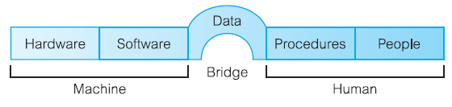
Components of D B M S Environment (1 of 3)

Slide 18
Components of D B M S Environment (2 of 3)
Hardware
Can range from a P C to a network of computers.
Software
D B M S, operating system, network software (if necessary) and also the application programs.
Data
Used by the organization and a description of this data called the schema.

Slide 19
Components of D B M S Environment (3 of 3)
Procedures
Instructions and rules that should be applied to the design and use of the database and D B M S.
People

Slide 20
Roles in the Database Environment
Data Administrator (D A)
Database Administrator (D B A)
Database Designers (Logical and Physical)
Application Programmers
End Users (naive and sophisticated)

Slide 21
History of Database Systems
First-generation
Hierarchical and Network
Second generation
Relational
Third generation
Object-Relational
Object-Oriented

Slide 22
Advantages of D B M S s (1 of 2)
Control of data redundancy
Data consistency
More information from the same amount of data
Sharing of data
Improved data integrity
Improved security
Enforcement of standards
Economy of scale

Slide 23
Advantages of D B M S s (2 of 2)
Balance conflicting requirements
Improved data accessibility and responsiveness
Increased productivity
Improved maintenance through data independence
Increased concurrency
Improved backup and recovery services

Slide 24
Disadvantages of D B M S s
Complexity
Size
Cost of D B M S
Additional hardware costs
Cost of conversion
Performance
Higher impact of a failure

